Slide 1

Stock Price Prediction using LSTM in Deep Learning
-By
Nivedhitha Selvaraj

Slide 2
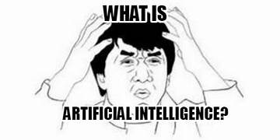

Slide 3

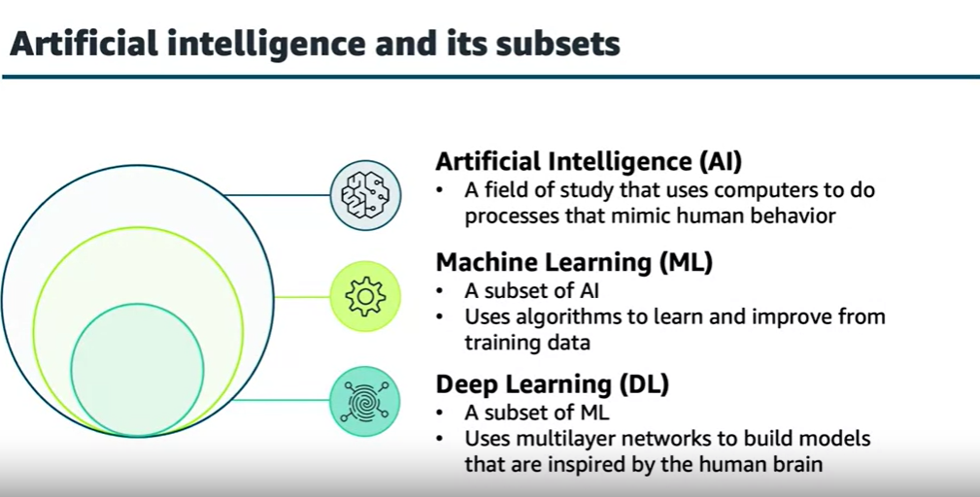
ARTIFICIAL INTELLIGENCE

Slide 4
Cont…
While traditional ML algorithms require manual feature engineering, deep learning uses neural networks to automatically learn features from large amounts of data.
Neural network:
A Neural Network is a computational model inspired by the structure and function of the human brain. It is a key component of artificial intelligence (AI) and machine learning (ML), particularly in the field of deep learning.
Neurons: Just like the brain, a neural network consists of units called neurons (or nodes). These neurons are connected by links, each of which has an associated weight.
Input layer
Hidden layer
Output layer
How its works;
The neuron receives inputs (e.g., features like stock prices).
The weighted inputs are summed, and a bias is added.
Each input is multiplied by a corresponding weight.
The sum is passed through an activation function (e.g., sigmoid, ReLU) to produce an output.
This output is passed to the next layer of neurons.
Types of Neural Network algorithms:
ANN
CNN
RNN
LSTM
etc…

Slide 5
What is lstm and Why LSTM ???
LSTM Strengths:
LSTM (Long Short-Term Memory) is a special type of Recurrent Neural Network (RNN) designed to overcome the vanishing gradient problem and capture long-term
Overall Objective:
When training on long sequences, the gradients (the values used to update the model) tend to shrink, making it hard for the network to learn long-term dependencies.
This is where LSTMs come in.

Slide 6
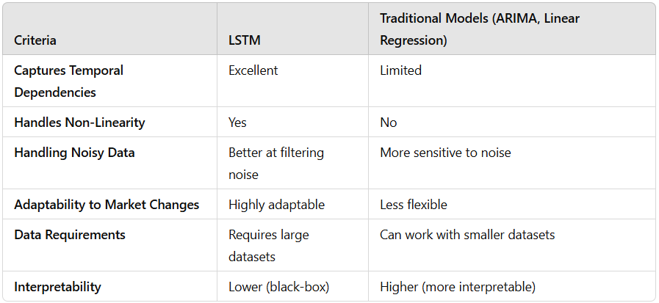
Cont…

Slide 7
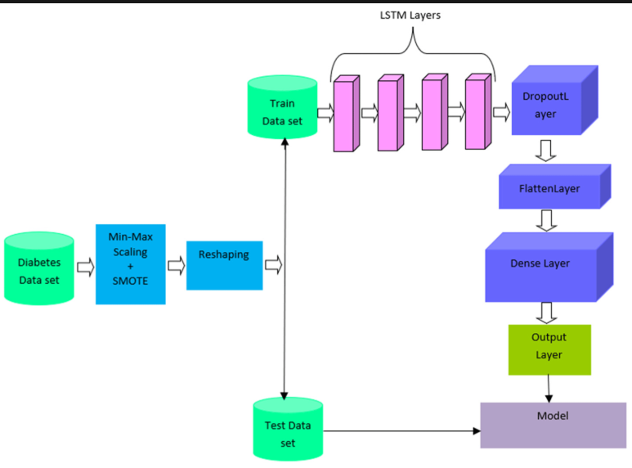



cont….
LSTM Layer:
LSTM is a type of Recurrent Neural Network (RNN). It's designed to handle sequential data, like time series (stock prices, weather data, etc.). Unlike regular neural networks, which process inputs independently, LSTM remembers past information and uses it to predict future outcomes. This ability to remember past data makes LSTM ideal for time series predictions.
This line adds a Dense layer with 1 output neuron. The Dense layer is fully connected, and the output of this layer is the predicted stock price.
TCS Dataset

Slide 8
LSTM Output: Suppose you have 5 timesteps (past 5 days of stock prices). After processing these 5 days, the output will be in a 3D shape:
For example:(1, 5, 50) (1 sample, 5 timesteps, 50 features).
Flatten Layer: This flattens the 3D array into a 1D array, changing it from (1, 5, 50) to (1,250) (1 sample, 250 features).
This flattened layer turns the 3D output into a 2D vector: one vector per sample, where each element of the vector represents a feature (a stock price in this case)
Now, the Dense layer can easily process this 2D data and predict the stock price.
The Dropout Layer is like a safety mechanism to prevent overfitting by forcing the model to learn more general patterns rather than memorizing the training data.
Imagine you are training for a math exam, and you have an exam prep book.
If you memorize the solutions from the book (like memorizing formulas or answers without understanding them), you'll probably perform well on similar problems, but struggle with new, unseen problems during the actual exam.
But, if you practice solving different types of problems, and don’t rely on memorization, you’ll do much better on unseen problems in the real exam.

Slide 9
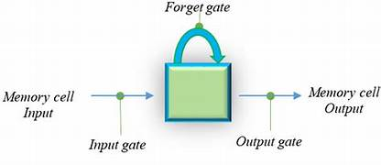
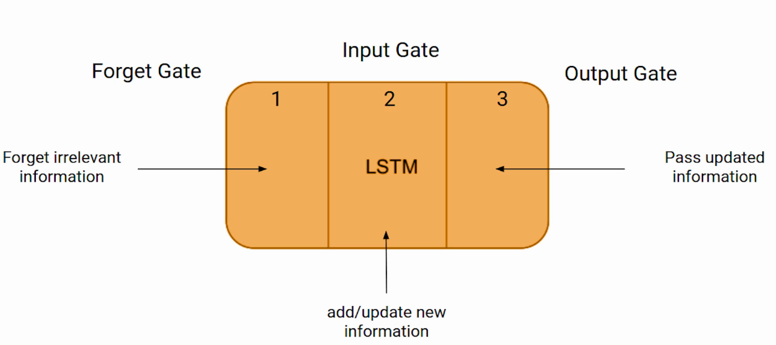
LSTM (Long short time Memory)

Slide 10
Problem statement
Stock Market Complexity:
Stock prices are influenced by numerous factors, such as market sentiment, global events, and economic indicators.
Traditional statistical models (e.g., ARIMA) struggle to capture non-linear relationships and dynamic patterns in stock price data.
Sequential Nature of Data:
Stock prices form time series data, where past prices influence future ones.
Long-term dependencies are critical in predicting stock price movements.
Challenges in Traditional Time Series Models:
Difficulty in handling large, unstructured, and non-linear data.
Lack of capacity to capture long-range dependencies.
Prone to overfitting in complex scenarios.

Slide 11



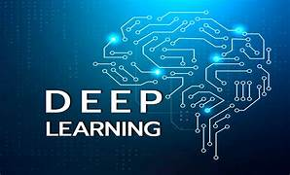
Tech stack

Slide 12
Approach:
Environment setup
Data collection
Data Processing (Cleaning and removing noise)
Labeling data
Train data using LSTM
Test data for model efficiency
Git Hub –Committing the code to the version control system.

Slide 13
Implementation:
Tensor Flow :
Deep learning library
Helps build a neural network that could learn from past historical patterns and make predictions based on it.
Scikit-learn:
Helps to split training and test datasets and to evaluate the model.

Slide 14
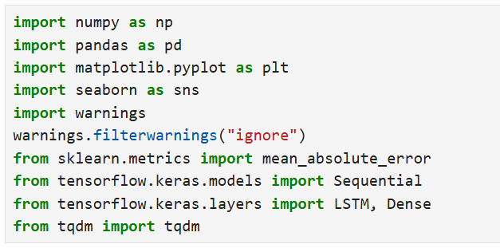
LSTM :
Layers that are designed to remember patterns over time
Dense :
A Dense layer is the simplest type of neural network layer where every neuron (node) is connected to every other neuron in the previous and next layers.
Mean_absolute_error :
To check how close our prediction is to the actual stock price
Sequential :
Builds layer-to-layer deep learning model
Helps to stack the different layers (LSTM & Dense) in neural networks.

Slide 15
How LSTM and Dense Work Together:
LSTM Layer:
Processes the time-series data (stock prices) and learns patterns over time.
Dense Layer:
After LSTM has understood the sequence, the Dense layer uses that information to make the final prediction, such as predicting tomorrow’s stock price.

Slide 16
python library used to display progress bars to keep track of the progress of a task, like training a machine learning model or processing a large dataset. It shows how much of the task is completed, how much time is left, and the speed at which the task is progressing.
TQDM :
Key Features:
Progress bars: Shows a visual representation of how far along the task is.
Time estimation: Estimates how much time is left to complete the task.
Updates in real-time: As each step of a loop is completed, the progress bar updates in real-time.

Slide 17
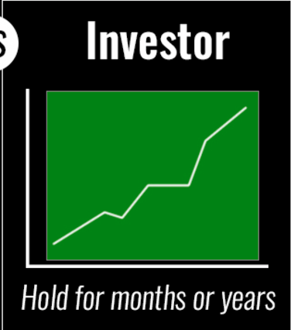
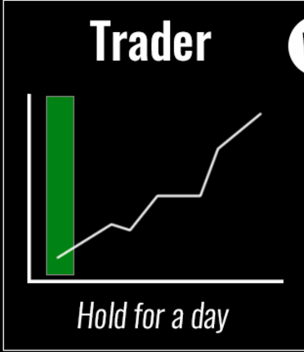
moving average
INVESTORS
TRADERS
Investor selecting the stocks by using fundamental analysis like a
Balance sheet ver
Profit & loss stm
Dividends
Etc…
Based on technical analysis like a
Market trends
Ups
Downs
Notes:
movi

Slide 18
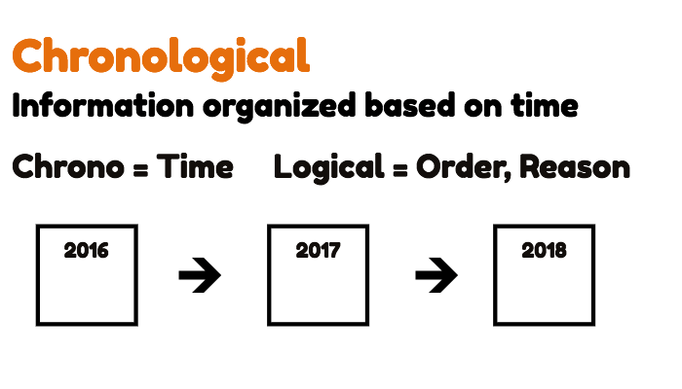

Slide 19
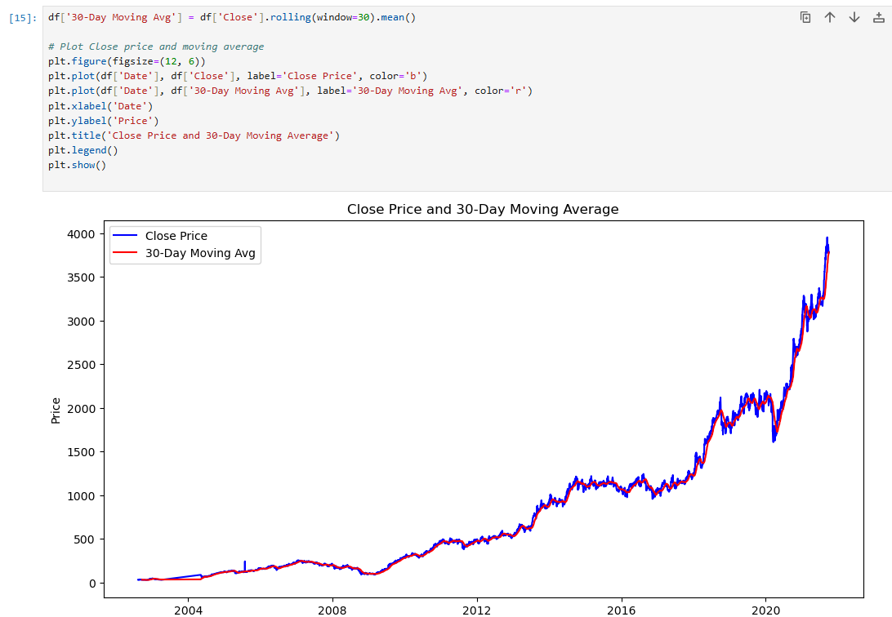

Slide 20

Thank you
Git - https://github.com/Nivedhithaselvaraj/Stock-Price-Prediction_Deep-Learning

